Slide 1
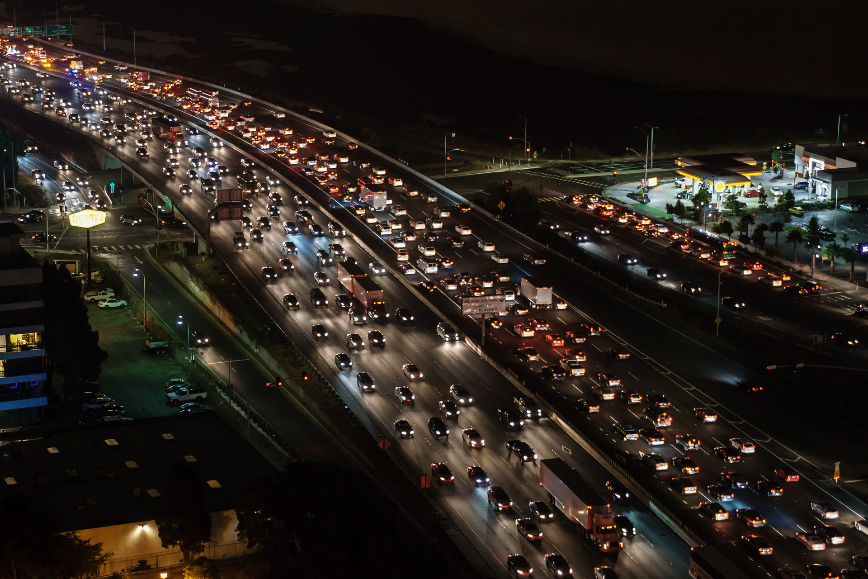
Bengaluru
TRAVEL OPTIMIZATION
Hertech Hackathon
By Madhavi Raman, HariShankar.G

Slide 2
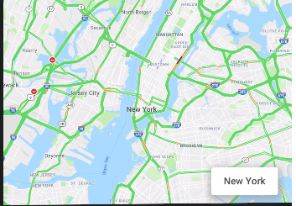
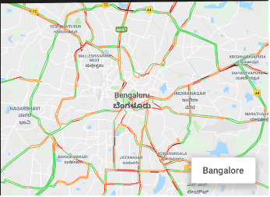
Problem statement in numbers
Bangalore is home to 2Mn Office goers
Expanded twice its size in 40 years and 6000% increase in number of vehicles on the street.
Below is the live traffic from New york and Bangalore taken on a Saturday evening.
Some stats : New York - 10,200 people/km² , Bangalore- 6,000 people/km². However when observed, Bangalore’s traffic is very congested compared to New York.
avoidable social cost of traffic congestion in Bengaluru at Rs.38,000 crore annually *

Slide 3
Our Solution
For the Hackathon challenge, we are proposing solution for the 3 usecases
Recommendation Engine for Optimizing Office commute (with a demo)
Fastest route vs Safe route
Alternate Transport

Slide 4
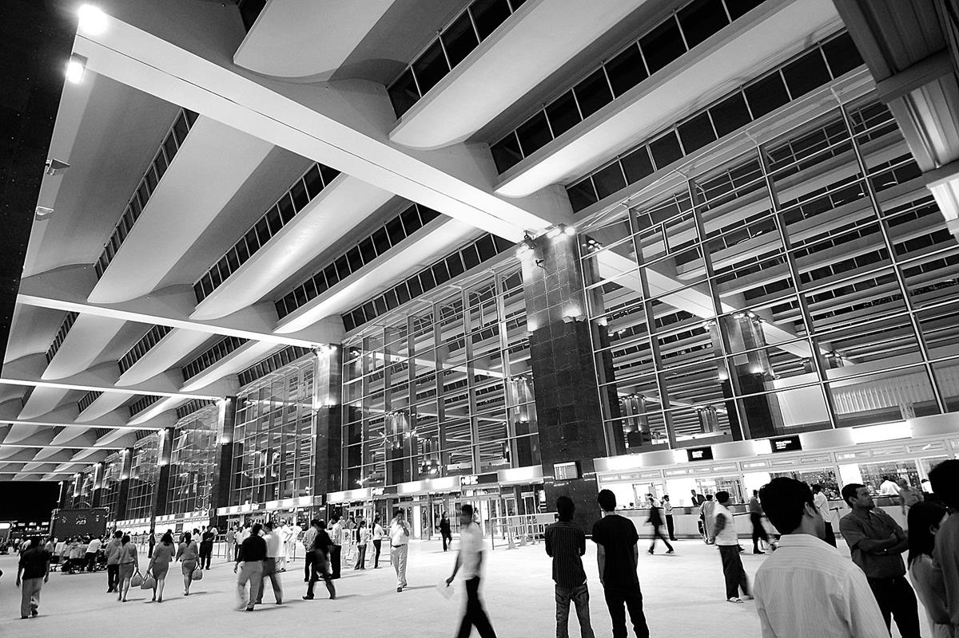
Use Case 1 Recommendation Engine for Optimizing Office Commute Time
1) Home & Office are stored in favorites
2) From historical data, we know the average time taken to go from Vijayanagar & Whitefield (Travel times , wards datasets)
3) We have data for 5 different time segments of a day (early morning, AM peak, midday, evening, PM peak) (Travel times daily dataset)
4) We have historical data for travel time for every day of the week (travel time day of the week dataset)
5) From all the above data, we will create a recommendation engine, which will give 3 recommendations for starting the journey. (Recommendation will be available from previous night, as a message, so the lady can plan her next day’s travel start time)
Notes:
Consider talking about:
Air
Namma Metro (Rail)
Road

Slide 5
Use case 2 Fastest Vs Safest Route recommendation
Notifying safe zones on the chosen path, & alternate path (costly path) with more safe zone coverage
e.g. Fastest route – 90 mins to cover 20 kms
Safest route – 105 minutes to cover 20 kms
Use case 3 Multi modal Transport recommendation
Giving alternate routing solution with a mix of public and private transport including last mile connectivity
e.g. origin – auto 2 kms – metro 18 kms – rental cycle pod to office 2 kms.
Using this Solution mix, you reach destination in 100 minutes
Notes:
Consider talking about:
Air
Namma Metro (Rail)
Road

Slide 6
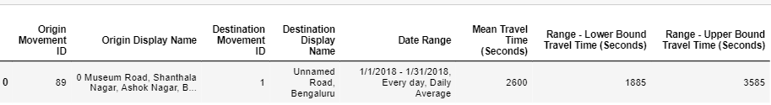
DataSETs Used
We have exported data from Uber Movement. It is a open source status data of Bangalore traffic from 01/01/2018 to 31/01/2018.
bangalore-wards-2018-4-All-HourlyAggregate.csv
Travel_Times.csv
Travel_Times_Daily.csv
Travel_Times_day_of_week.csv
Travel_Times_time_of_day.csv

Slide 7
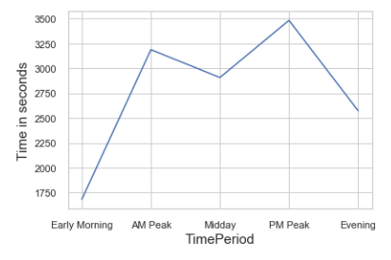
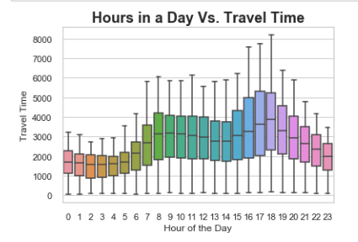
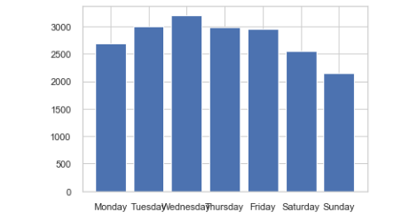
Exploratory Data Analysis
Observation 1:The average Time taken for travel between source and destination is 46 mins at any given day.
Observation 2: The travel time peak at the morning say(8-11) and also during the evening(6-8). It is the time when people either rush from or to workplace.
Observation 3: It is traffic model between the source and destination on all days of the week.
Source – Vijayanagar
Destination - Whitefield

Slide 8
Proof of concept using MS Azure

Slide 9
Revenue Model
Freemium model for individual users for 1 year (25k users*)
Rs.10 Per month for recommendations per user after year one (10k*)=Rs1L
Push ads at the end of trips for freemium users. Rs.1 Per ad from B (20k trips*10rs*200 days = Rs.4Crores
* Projection

Slide 10
Solution Roadmap
Identification of problem statement, business validation
Acquisition of datasets, data cleaning, EDA, choosing algorithm, models
Implementing Usecase1
Pilot roll out of Usecase 1, implementation of usecase 2
Integrated solution roll out to commercial customers all 3 usecases
00
01
02
03
04
05
06
07
08
09
10
11
12
Apr
May
June
Jul
Aug
Sep
Oct
Nov
Dec
Jan
Feb
Mar
Apr
Start
Q2
Q3
Q4
Q1

Slide 11
Thanks

